Slide 1
The Migratory Agreements between Mexico and the U.S. of June 7, 2019
Rafael Fernández de Castro
Smart Border Coalition
July 18, 2019

Slide 2
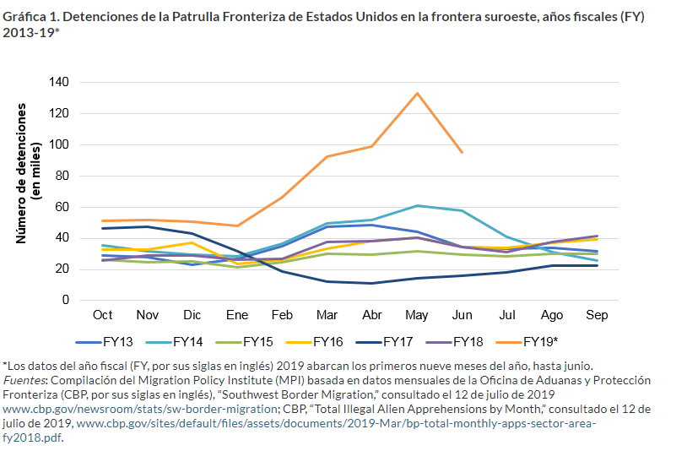
Detentions by CBP in the Southwest Border, Fiscal Years (2013-19)

Slide 3
Apprehensions at the US Southern border Fiscal Year 2019

Slide 4
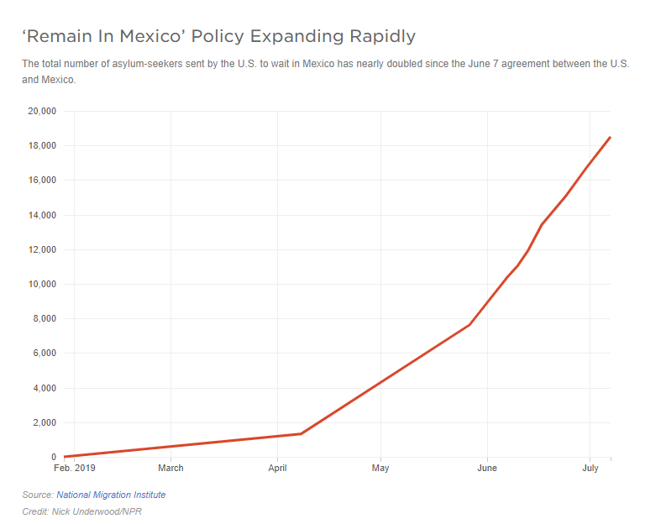
Remain in Mexico Policy

Slide 5
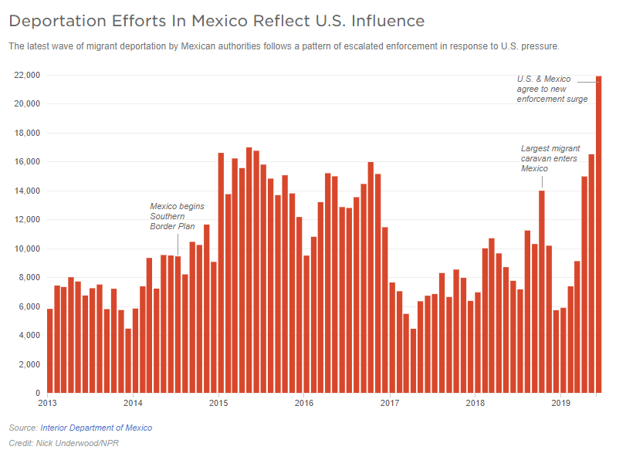
Mexican Deportation Efforts

Slide 6
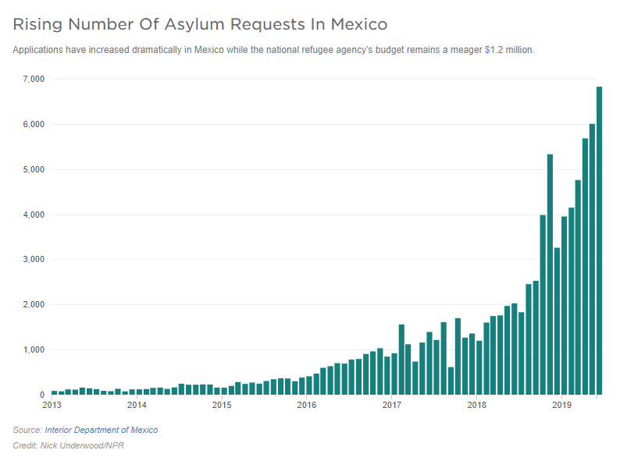
Rising Number of Asylum Requests in Mexico

Slide 7
Apprehensions at the US Southern Border (Single Adult vs. Family Units/Unaccompanied Minors)

Slide 8
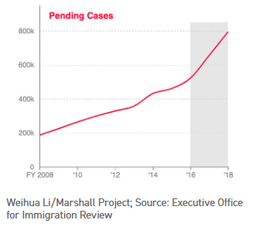
Pending Cases

